Slide 1
Table Presentation
David Hemenway

Slide 2

A Simple Table

Slide 3
Define a table
“A systematic arrangement of data usually in rows and columns for ready reference” Collegiate Dictionary, Merriam Webster, 1999
“A summary table tallies the set of individual values as frequencies or percentages for each category” “Statistics for Managers Using Microsoft Excel, Levine, Stephan, and Szabat, 2017

Slide 4
Essential Table Elements - Mechanical
Title
Information
Total(s) for vertical and horizontal spaces
Number of cases
Source(s)
Professional appearance
Formatting
Font selection and sizes (make them consistent for different sections of a table)
Footnote(s) showing spreadsheet information

Slide 5
Simple Sample Table
ECSU BUS 205 Bookstore
 |  |  | Total
Description | Quantity | Price | Cost
Office Book | 1 | $250.00 | $250.00
MIS Book | 1 | $100.00 | $100.00
Heavy Duty Book Bag | 1 | $49.95 | $49.95
New Computer | 1 | $679.00 | $679.00
Binder for Class Project | 1 | $1.56 | $1.56
Pointer for Power Point Presentation | 1 | $9.95 | $9.95
Cushion for Long Classes | 1 | $12.50 | $12.50
Travel Mug for Caffeinated Beverage | 2 | $13.50 | $27.00
Total |  |  | $1,129.96
Source: KD Made-Up Data
Author:
Date:
Purpose:

Slide 6
Essential Table Elements - Design
KISS
Appropriate for the audience
Tell a story
Does the table do what you want it to do?
Complies with professional standards in your field.
The table is consistent with your organization’s standards (formal or informal)

Slide 7
Tables – Best Practices
Tables should be friendly – not intimidating.
Table should be “Our” table, not “My” table if the table has information from several units within an organization. If appropriate, list the contributors of the data for the table in the sources area.
Make sure the table is consistent with the organization’s values.
If this table is very important to your organization, share the format and design with appropriate colleagues before adding any data. Have them critique the design and layout.
Before using an important table, check it over for errors AND have a close colleague check it out for you.
Make a library of commonly used tables instead of recreating one each time you need one.

Slide 8
Simple One by Two Table
Title
 |  | Number | Percent
 | Yes |  | #DIV/0!
 | No |  | #DIV/0!
 | Total | 0 | #DIV/0!
Source:

Slide 9
Two by Six Table
Title
 | Stongly | Agree | Neither Agree | Disagree | Strongly
 | Agree |  | nor Disagree |  | Disagree | Total
Item 1 | 0 | 0 | 0 | 0 | 0 | 0
% | #DIV/0! | #DIV/0! | #DIV/0! | #DIV/0! | #DIV/0! | #DIV/0!
Item 2 | 0 | 0 | 0 | 0 | 0 | 0
% | #DIV/0! | #DIV/0! | #DIV/0! | #DIV/0! | #DIV/0! | #DIV/0!
Source:

Slide 10
Six by 4 Table
Title
 | Not | Always | Frequently | Occasionally | Rarely | Never
 | Applicable | Missed | Missed | Mised | Missed | Missed | Total
Item 1 | 0 | 0 | 0 | 0 | 0 | 0 | 0
% | #DIV/0! | #DIV/0! | #DIV/0! | #DIV/0! | #DIV/0! | #DIV/0! | #DIV/0!
adjusted % | -- | #DIV/0! | #DIV/0! | #DIV/0! | #DIV/0! | #DIV/0! | #DIV/0!
Item 2 | 0 | 0 | 0 | 0 | 0 | 0 | 0
% | #DIV/0! | #DIV/0! | #DIV/0! | #DIV/0! | #DIV/0! | #DIV/0! | #DIV/0!
adjusted % | -- | #DIV/0! | #DIV/0! | #DIV/0! | #DIV/0! | #DIV/0! | #DIV/0!
Item 3 | 0 | 0 | 0 | 0 | 0 | 0 | 0
% | #DIV/0! | #DIV/0! | #DIV/0! | #DIV/0! | #DIV/0! | #DIV/0! | #DIV/0!
adjusted % | -- | #DIV/0! | #DIV/0! | #DIV/0! | #DIV/0! | #DIV/0! | #DIV/0!
Item 4 | 0 | 0 | 0 | 0 | 0 | 0 | 0
% | #DIV/0! | #DIV/0! | #DIV/0! | #DIV/0! | #DIV/0! | #DIV/0! | #DIV/0!
adjusted % | -- | #DIV/0! | #DIV/0! | #DIV/0! | #DIV/0! | #DIV/0! | #DIV/0!
Source:

Slide 11
Tables - Challenges
How much information to put in a table? Too little to too much.
Is the table consistent with the type of tables routinely produced within the organization?
Is there a standard report within the organization that has been used to present this type of information? People are more comfortable with familiar report formats.

Slide 12


Slide 13
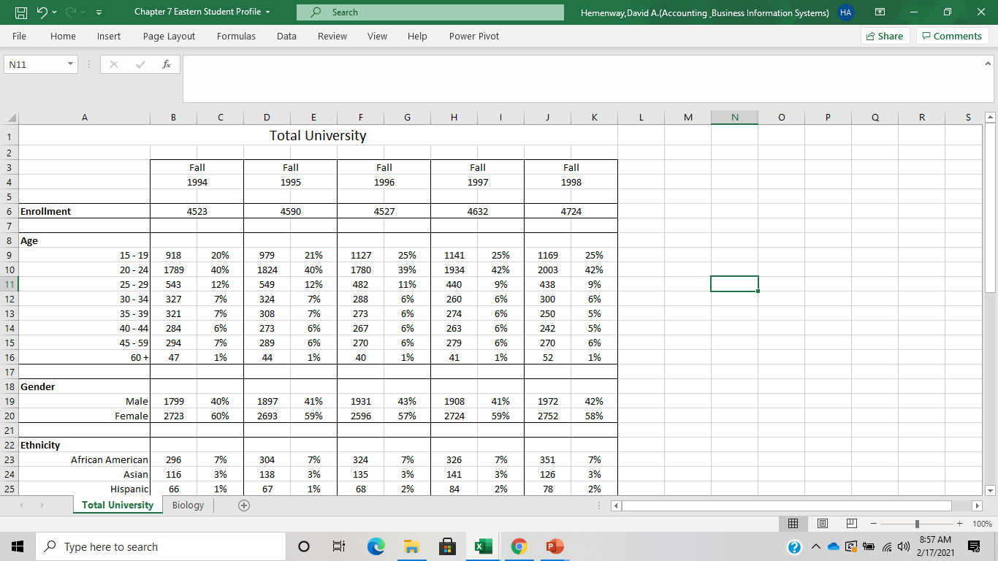

Slide 14
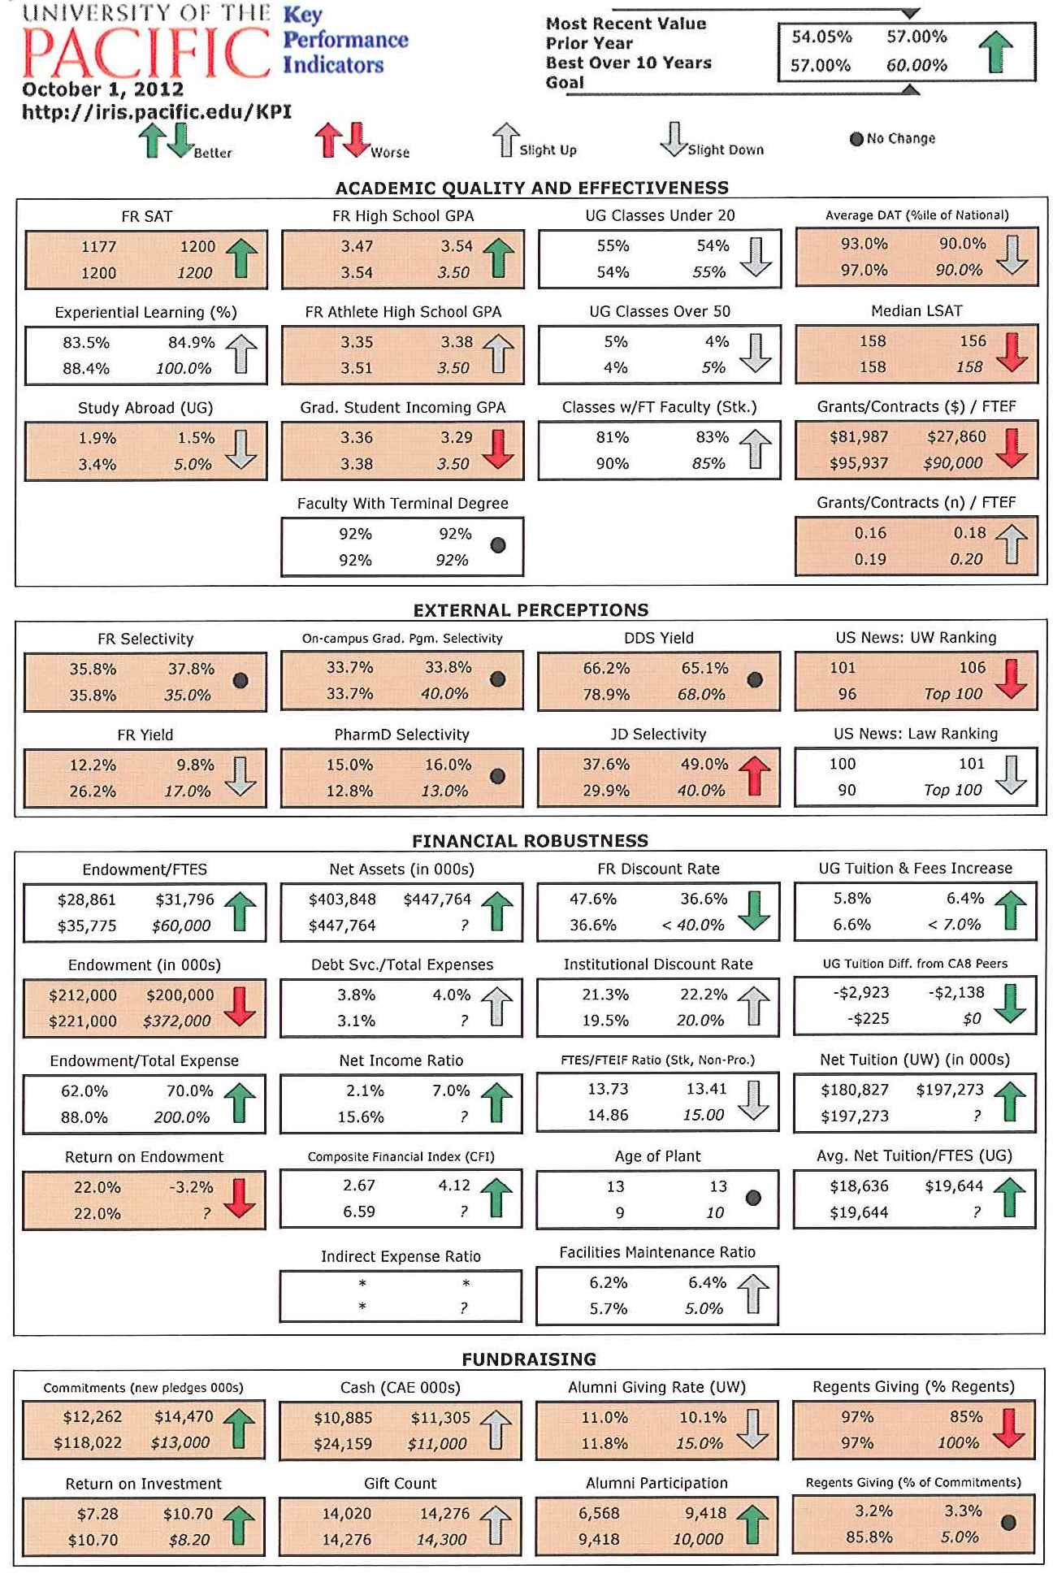

Slide 15
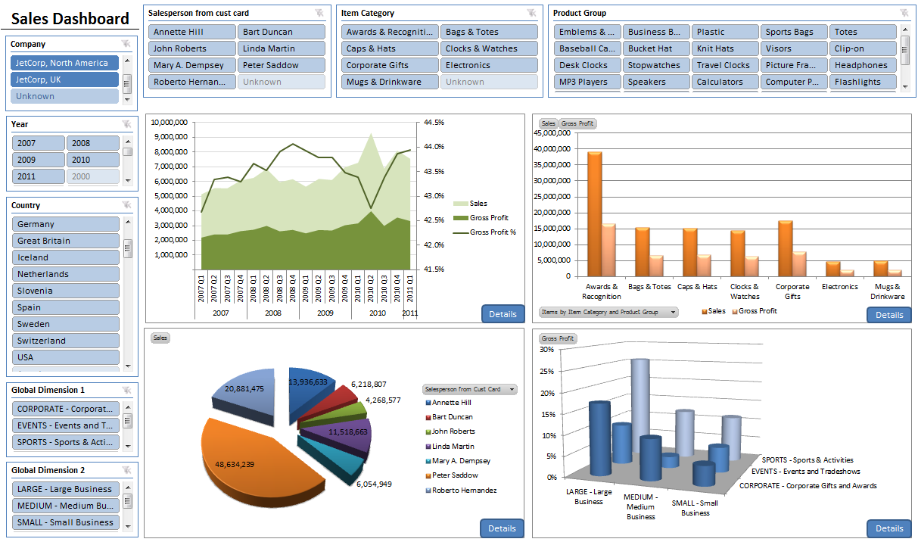
Business Intelligence Management Example
Image source: https://www.cbsi-corp.com/software/business-intelligence-reporting

Slide 16
Essential Table Elements - Ethical
Tell the whole story! Provide meaningful data by not skipping years which is called selective summarization. Example:
Stock Change Over Five Years
 |  |  |  |  |  | Change from | Change from
 |  |  |  |  |  | Previous | Five Years
Stock | Year 1 | Year 2 | Year 3 | Year 4 | Year 5 | Year | Ago
Stock A | $100 | $110 | $120 | $125 | $140 | 12% | 40%
Stock B | $100 | $105 | $115 | $120 | $140 | 17% | 40%
Stock C | $100 | $110 | $100 | $130 | $140 | 8% | 40%
Stock D | $100 | $90 | $95 | $140 | $140 | 0% | 40%
Stock E | $100 | $80 | $85 | $135 | $140 | 4% | 40%
Source: Dave Hemenway made up data

Slide 17
Essential Table Elements – Ethical continued
Tell the truth all the time.
Show all sources of information.
Don’t use a table for a short-term gain which will cause a long-term loss – especially if it affects your integrity.

Slide 18
Best Practices for Tables
KISS – Keep it Simple.
Provide Titles for table, rows and columns, Number of cases, Sources.
Verify your data! All information such be replicable- be able to calculate it again via formulas in the table.
Make all tables professional looking.
Provide the most accurate/honest information available.
Provide footnotes showing spreadsheet information

Slide 19
A Simple Table

Slide 20
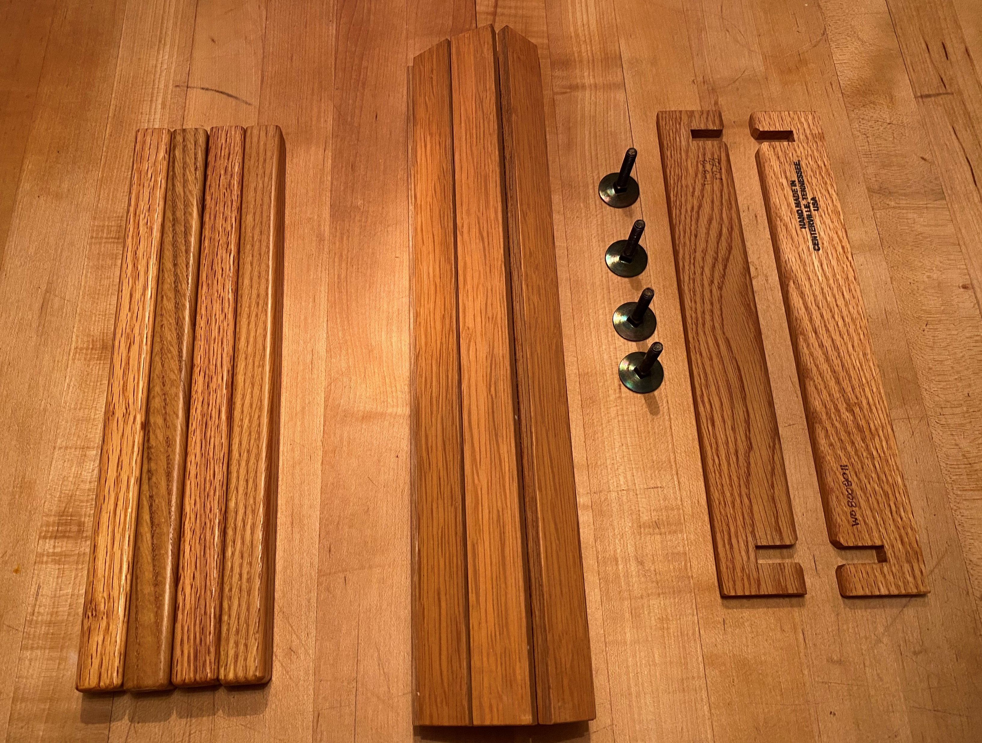

A Simple Table Continued

